Slide 1
Q&A for Xiaomi smartphone users:
Question |  | Page.
Q1 | A smartphone cannot receive a call with PUSH is ON. | 2
Q2 | A smartphone does not show Incoming Call screen during a incoming call. | 6

Slide 2
Q1 | A smartphone cannot receive a call with PUSH is ON.
A1 | After changing the following settings, please try if Push Notification works : Enable AutoStart feature Change the Battery setting Lock app on the Recents Screen. For details, see next page. *These steps are explained using the screen of Xiaomi MI5 (Android 6.0.1, MIUI 8.1).

Slide 3
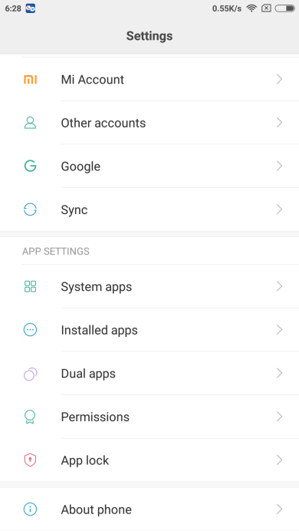
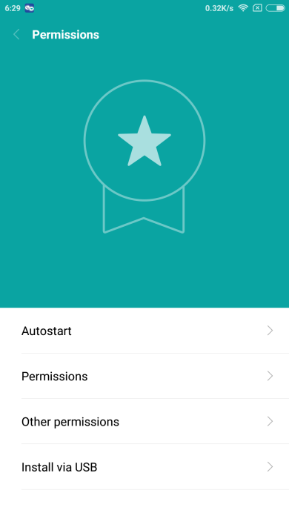
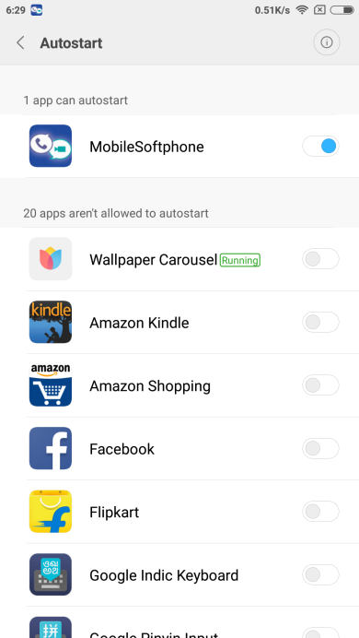
1. Enable AutoStart feature
On the Settings screen:
Select Permissions
Select AutoStart
Enable AutoStart for “MobileSoftphone” app.

Slide 4
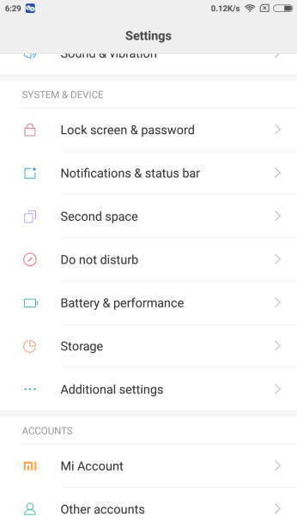
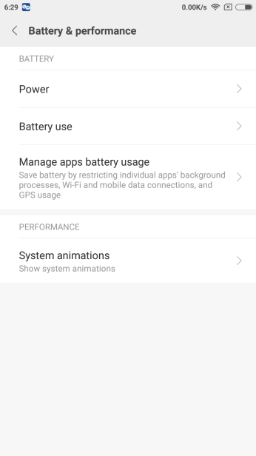
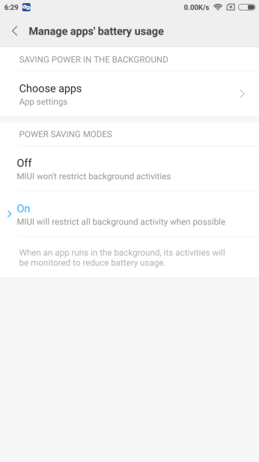
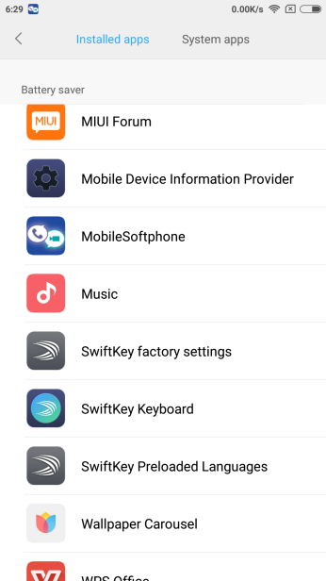
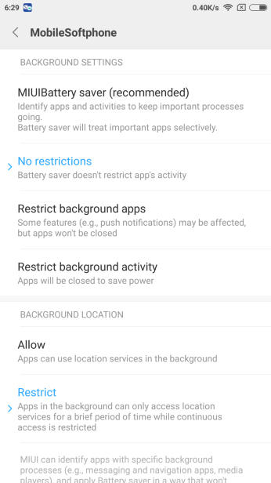
2. Change the Battery setting
On the Settings screen:
Select Battery & performance
Select Manage apps battery usage
Select Choose apps
Select “MobileSoftphone” app
Set “No restrictions” on BACKGROUND SETTINGS

Slide 5
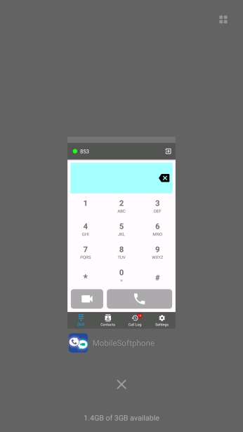
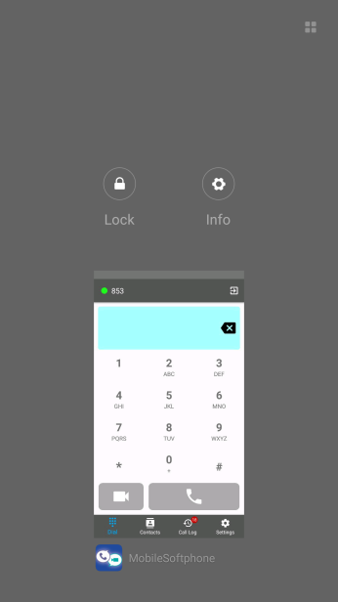
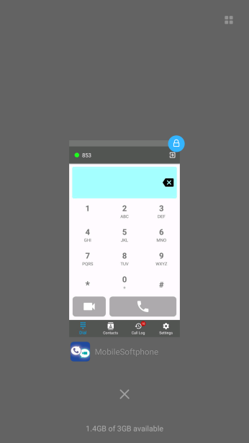
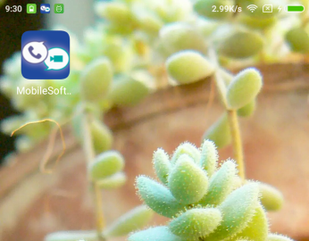
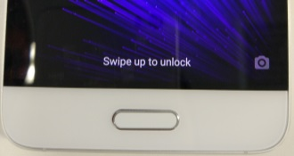
3. Lock app on the Resents Screen
On the Home screen:
Launch “MobileSoftphone” app
Go to Recent screen (Tap the left button on the bottom of your smartphone)
Swipe down on “MobileSoftphone” screen
Tap Lock to enable Lock
Confirm the lock mark is displayed on “MobileSoftphone” screen

Slide 6
Q2 | A smartphone does not show Incoming Call screen during a incoming call.
A2 | After changing the following settings, please try again: Change the Permission setting Change the Battery setting For details, see next page. *These steps are explained using the screen of Xiaomi MI5 (Android 6.0.1, MIUI 8.1).

Slide 7
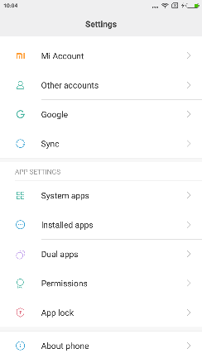
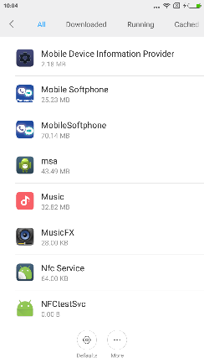
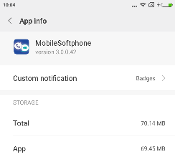
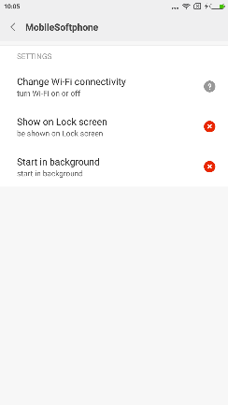
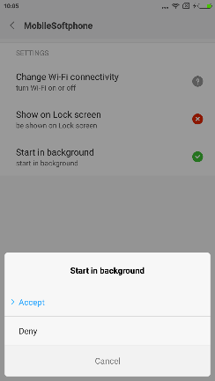
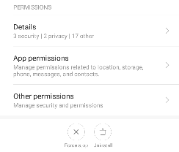
1. Change the Permission setting
On the Settings screen:
Select Installed apps
Select Mobilesoftphone
Select Other permissions
AutoStart for “MobileSoftphone” app.
Set Accept on the following permissions:
Show on Lock screen
Start in background
...

Slide 8
2. Change the Battery setting
On the Settings screen:
Select Battery & performance
Select Manage apps battery usage
Select Choose apps
Select “MobileSoftphone” app
Set “No restrictions” on BACKGROUND SETTINGS

